Slide 1

School of
Information Studies
GLIS 692 – Data Science for
Professionals
WEEK 1
06 Sept 2022

Slide 2
What is this course about?

Slide 3
Class Schedule
WEEK | DATE | TOPIC
1 | Septermber 06, 2022 | Introduction to and Data Science
2 | Septermber 13, 2022 | Programming Languages for Data Science - R
3 | Septermber 20, 2022 | Visualizations and Plotting
4 | Septermber 27, 2022 | Data Analytics and Model Building
5 | October 04, 2022 | Regression Analysis
6 | October 11, 2022 | Classification Part 1
7 | October 18, 2022 | MIDTERM
8 | October 25, 2022 | Classification Part 2
9 | November 01, 2022 | Dimensionality Reduction
10 | November 08, 2022 | Clustering
11 | November 15, 2022 | Text Analysis and Natural Language Processing
12 | November 22, 2022 | Text Analysis and NLP
13 | November 29, 2022 | Neural Networks + Producing a Data Science Report
14 | December 06, 2022 | FINAL EXAM

Slide 4
About the instructor

Slide 5

EDUCATION
WORK EXPERIENCE
Postdoctoral Researcher
McGill University
Montréal, Quebec (2021-present)
PhD in Machine Learning
Université de Bretagne Occidentale
Brest, France (2018-2021)
MS Statistics
University of Southern Philippines
Philippines (2011-2016)
MS Applied Mathematics
University of the Philippines
Philippines (2013-2016)
BS Mathematics
Mindanao State University
Philippines (2011-2016)
Lead Data Scientist
REFINITIV
France (2021-present)
Research Scientist
INSERM
Brest, France (2018-2021)
Data Science Consultant
Biofourmis
Singapore (June 2018- Aug 2018)
Senior Data Scientist
Neural Mechanics
Philippines (2017-2018)
Data Scientist
BCS Technology International
Philippines (2016-2017)
Statistical Specialist
Philippine Statistics Authority
Philippines (2015-2016)
RONRICK DA-ANO, PHD
Email:
ronrickarnaiz@gmail.com
Linkedin:
https://www.linkedin.com/in/ronrick-a-da-ano/

Slide 6
About you

Slide 7

What is Data Science?
As per Harvard Review, Data Scientists is considered as the sexiest job of the 21st Century.
It is an interdisciplinary field making use of scientific methods, processes, algorithms and systems for extracting knowledge and insights from structured and unstructured data and applies knowledge and actionable insight from data across a broad range of application domains.

Slide 8
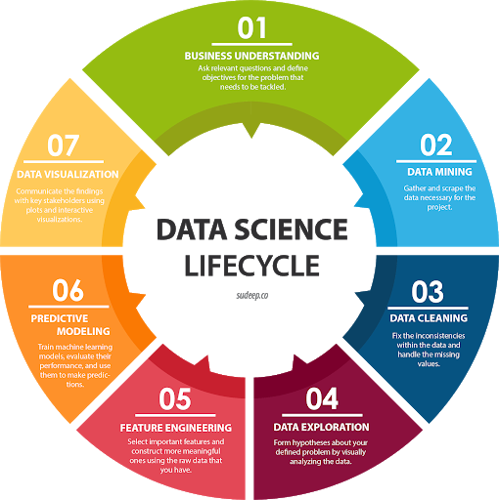
Data Science Lifecycle

Slide 9
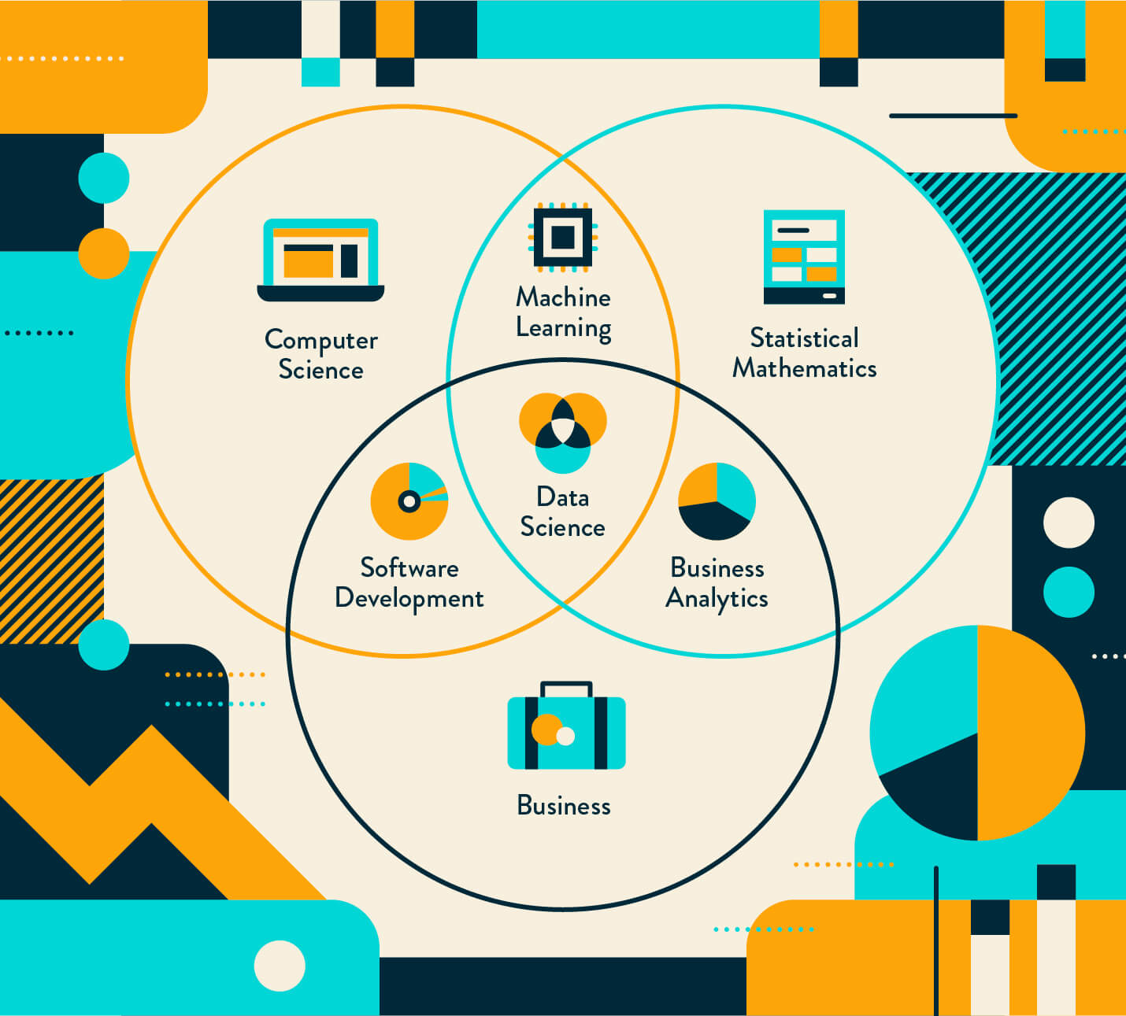
Why businesses need Data Science?
The amount of data created everyday has resulted in need for professionals to tackle and make sense of it. There is a huge mine of unstructured and semi-structured data coming from various sources and the traditional business intelligence tools are just not sufficient to make sense of it.
Hence, Data Science offers advanced tools for working on large volumes of data coming from various types of sources such as financial logs marketing forms, sensors, instruments, text files, and multimedia files.

Slide 10
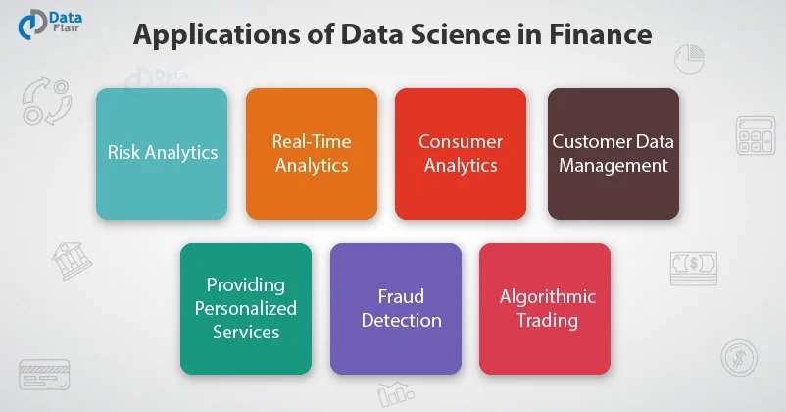
Application of Data Science?

Slide 11

Job Roles in Data Science?

Slide 12
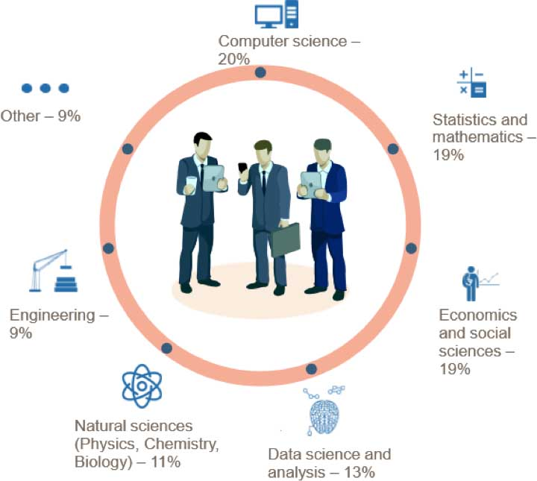
Who are Data Scientists?

Slide 13
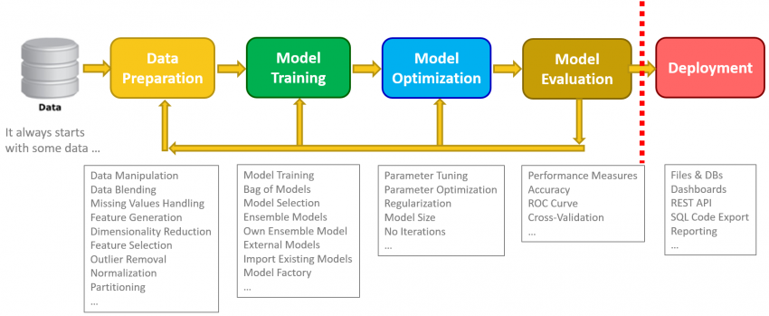
Data Science Steps?

Slide 14
DATA SCIENCE GLOSSARY

Slide 15

Data Science Evolution?

Slide 16

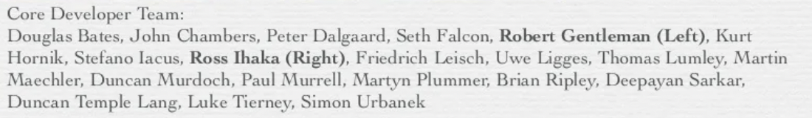
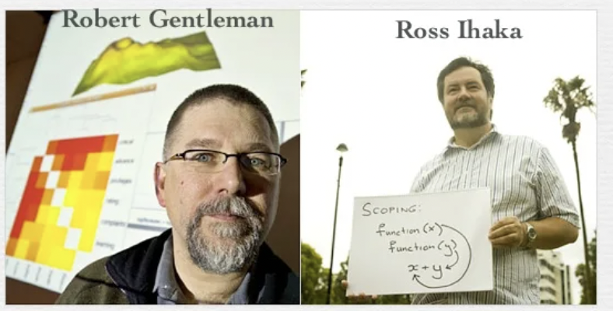
What is ?
A language and environment for statistical computing and graphics
Developed by Robert Gentleman and Ross Ihaka and the user community.

Slide 17
Why ?
It's free!
It runs on a variety of platforms including Windows, Unix and MacOS.
It provides an unparalleled platform for programming new statistical methods in an easy and straightforward manner.
It contains advanced statistical routines not yet available in other packages.
It has state-of-the-art graphics capabilities.

Slide 18
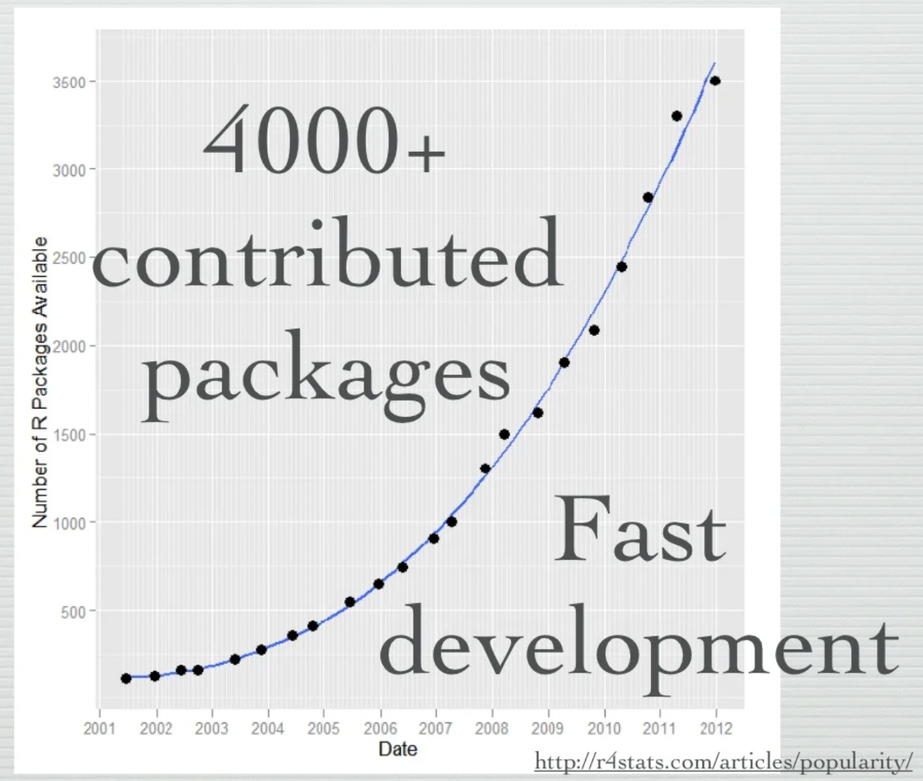
Why ?

Slide 19
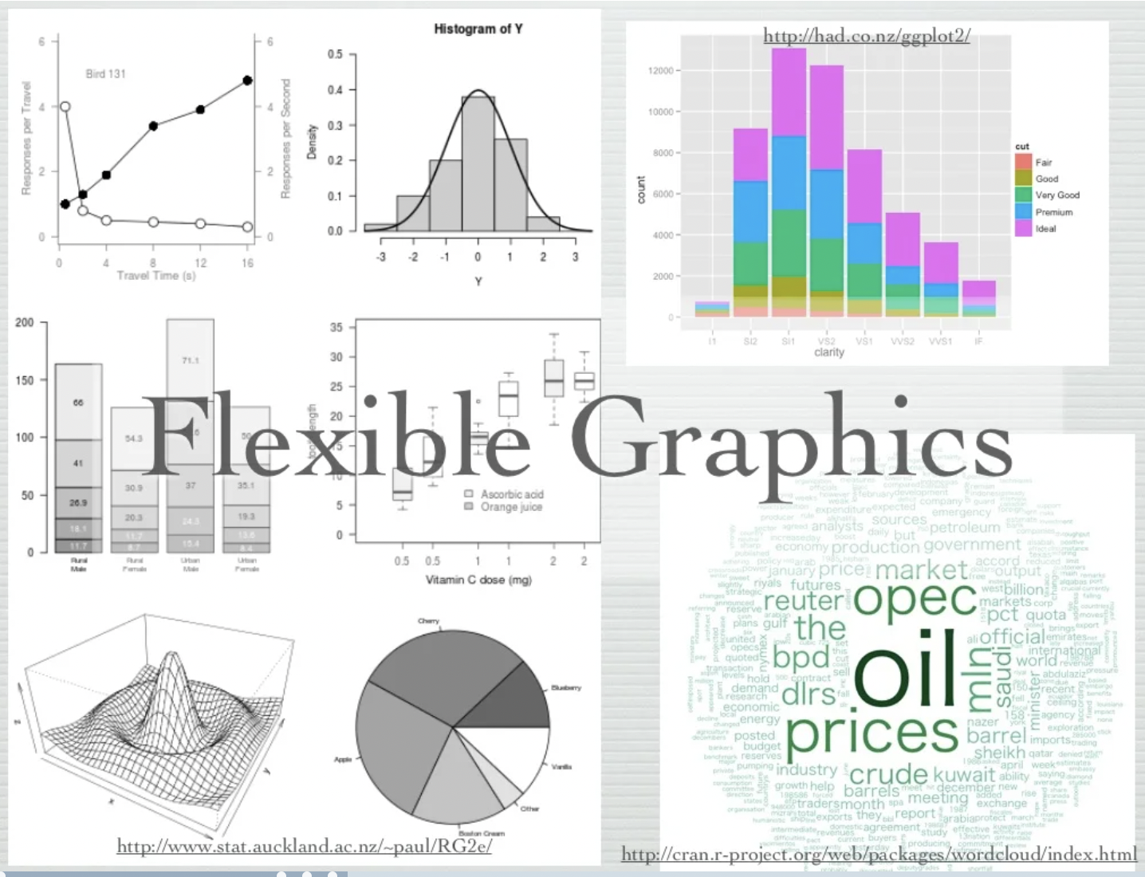
Why ?

Slide 20
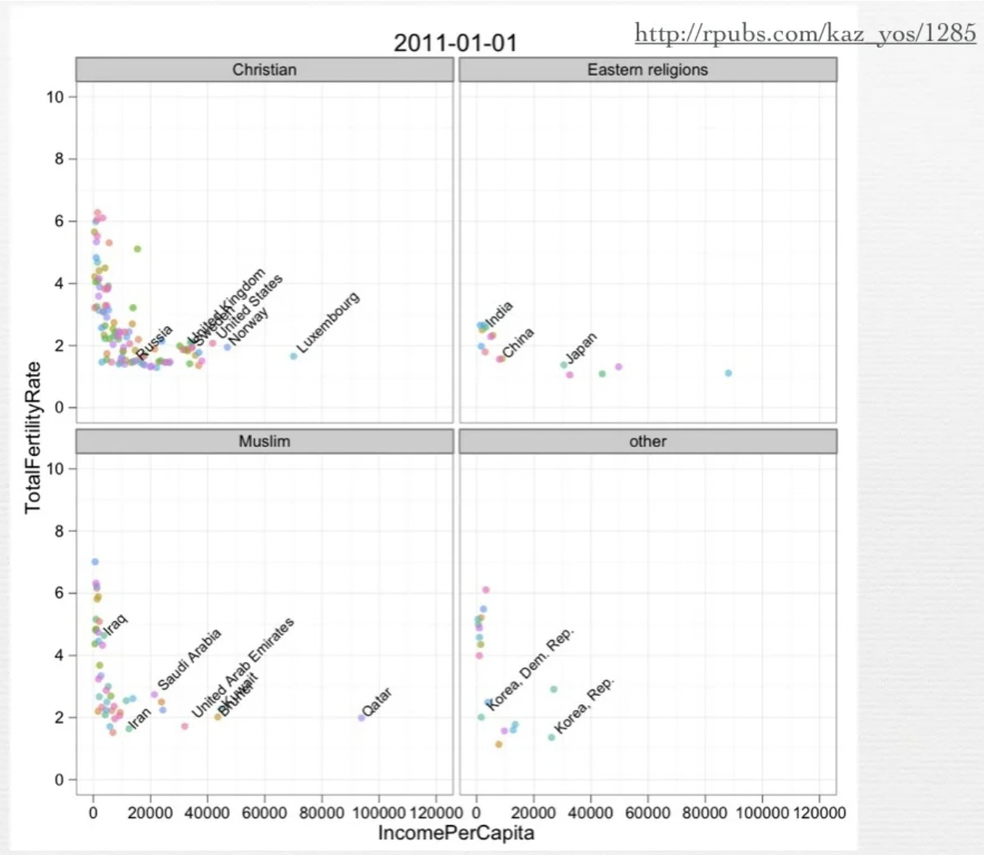
Why ?

Slide 21
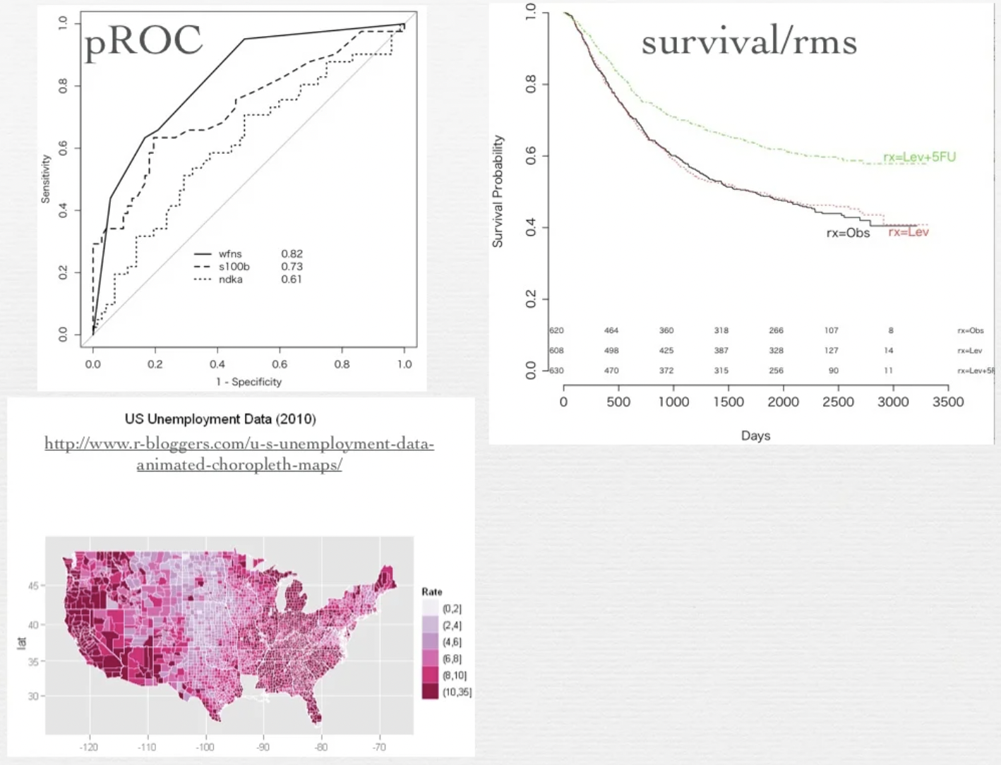
Why ?

Slide 22
How to download?
Google it using R or CRAN (Comprehensive R Archive Network)
http://www.r-project.org
And connect your GUI with R-Studio
https://www.rstudio.com/

Slide 23
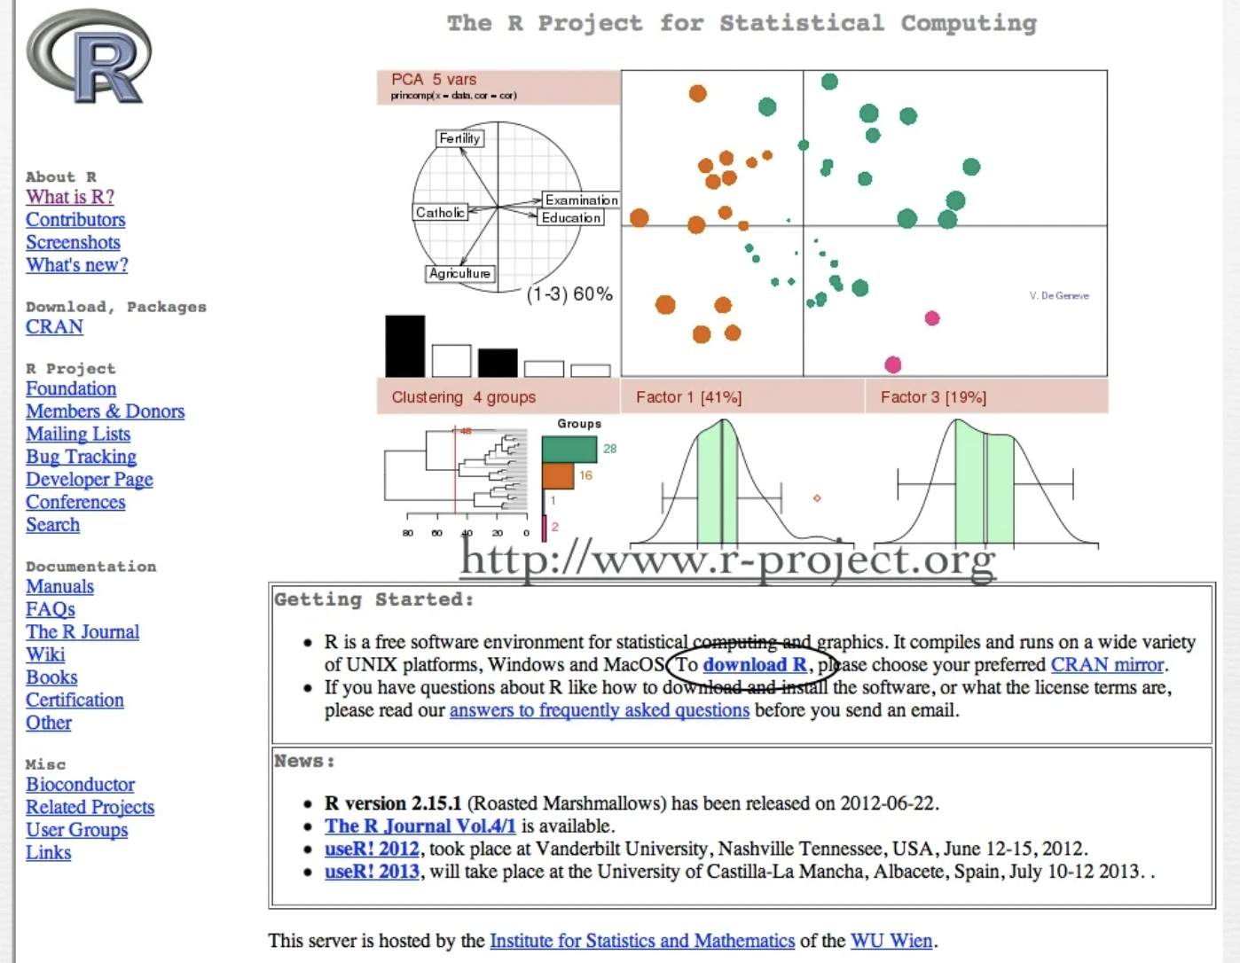
R Overview
R is a comprehensive statistical and graphical programming language and is a dialect of the S language:
1988 - S2: RA Becker, JM Chambers, A Wilks
1992 - S3: JM Chambers, TJ Hastie
1998 - S4: JM Chambers
R: initially written by Ross Ihaka and Robert Gentleman at Dep. of Statistics of U of Auckland, New Zealand during 1990s.
Since 1997: international “R-core” team of 15 people with access to common CVS archive.

Slide 24
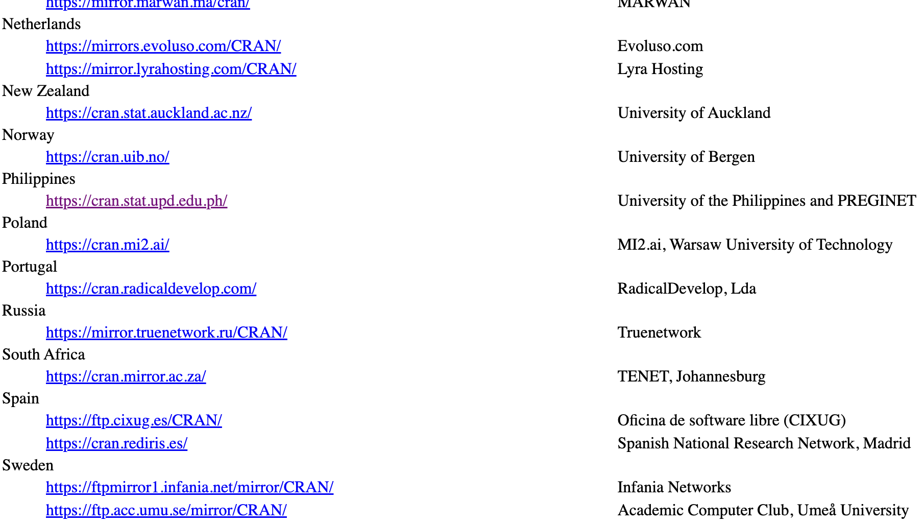
R Overview

Slide 25
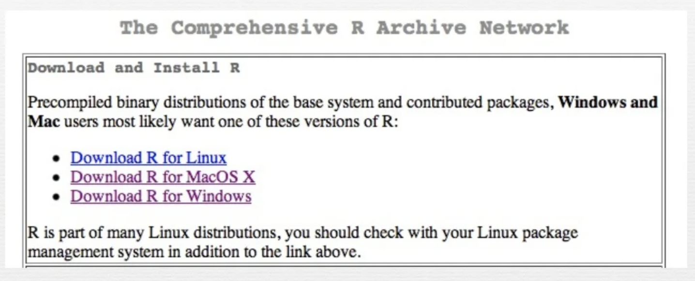
R Overview

Slide 26
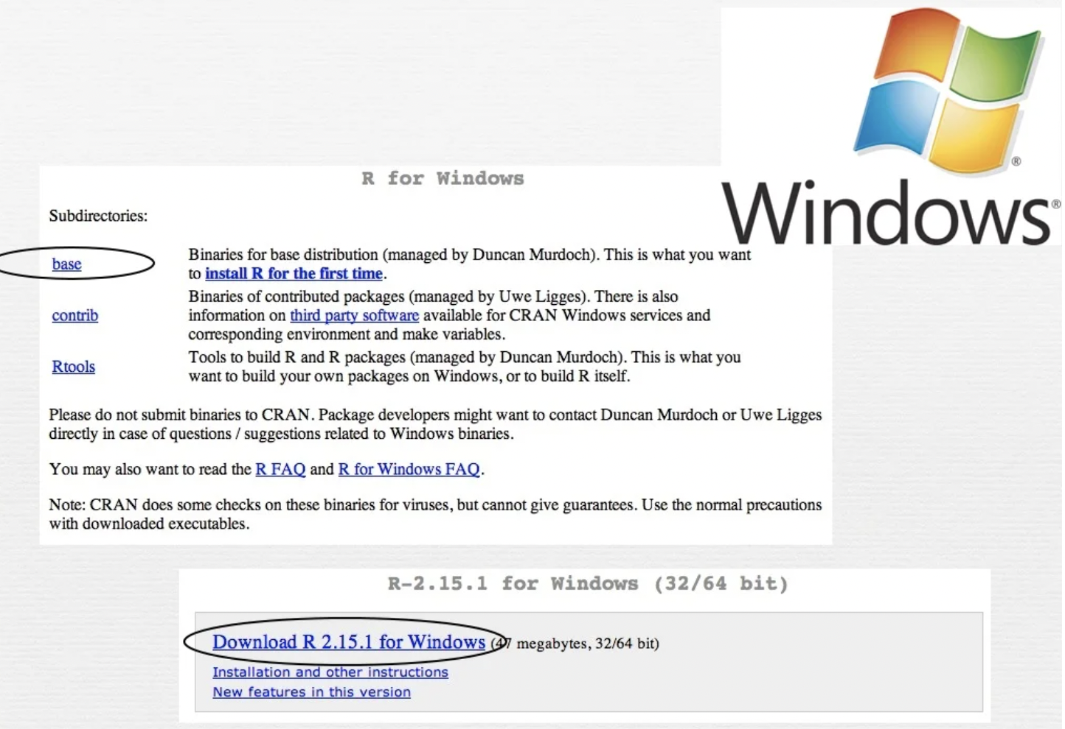
R Overview

Slide 27
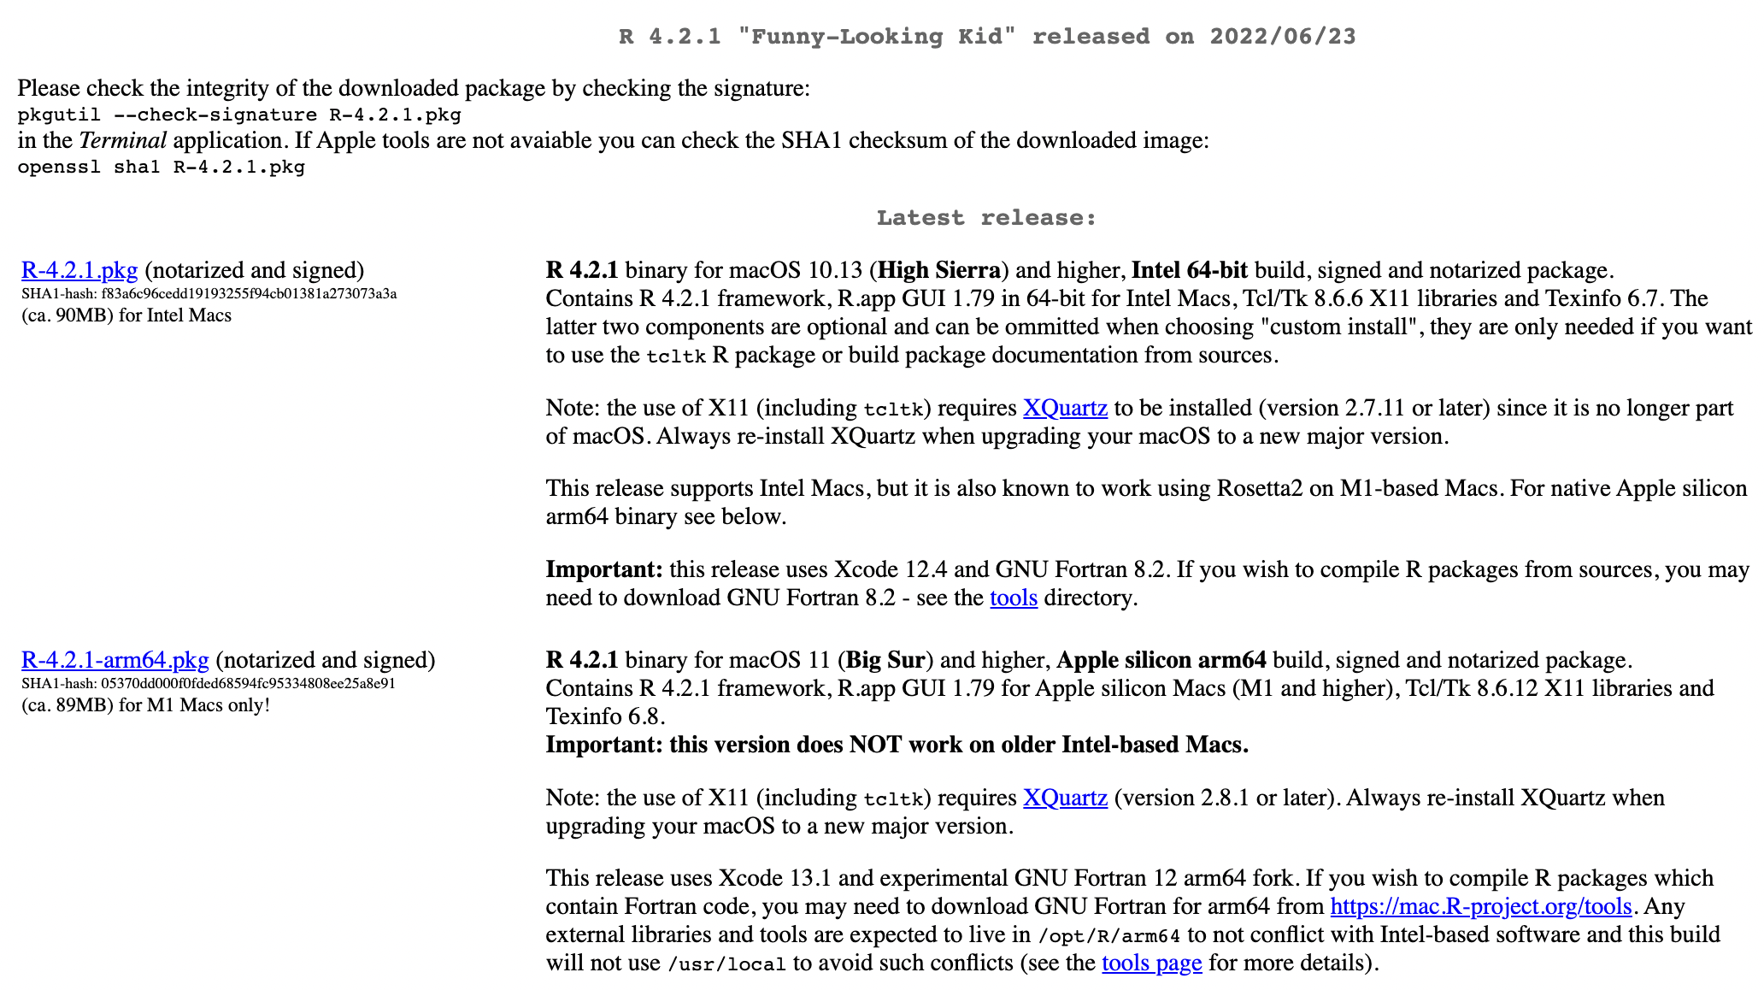

R Overview

Slide 28
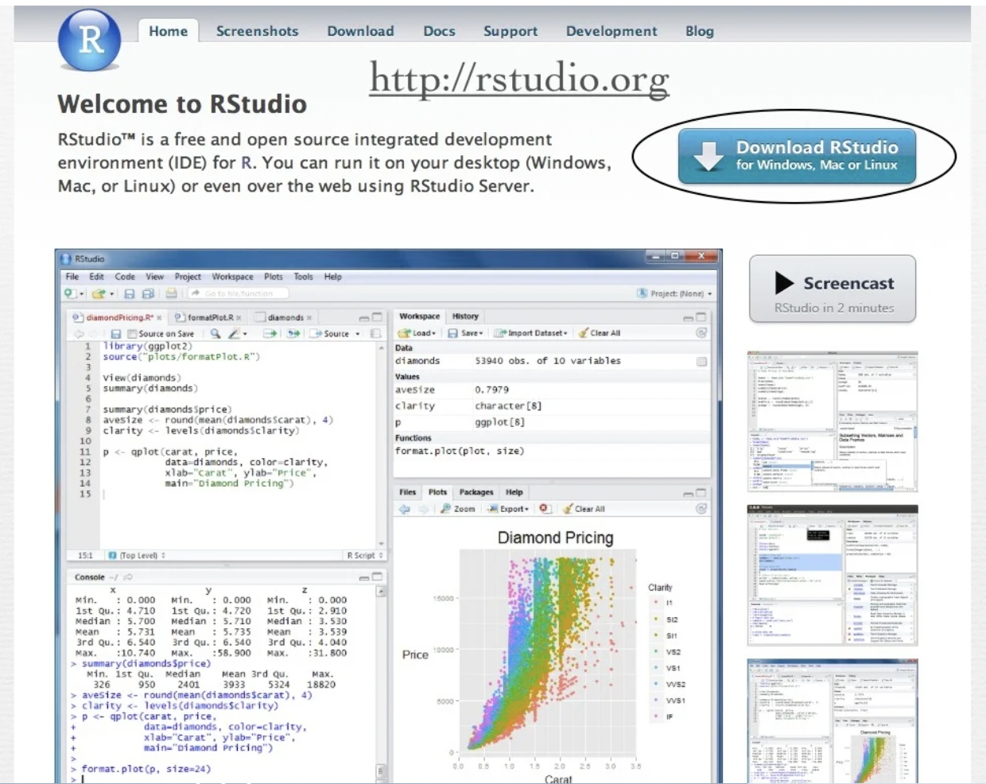
R Studio Overview

Slide 29
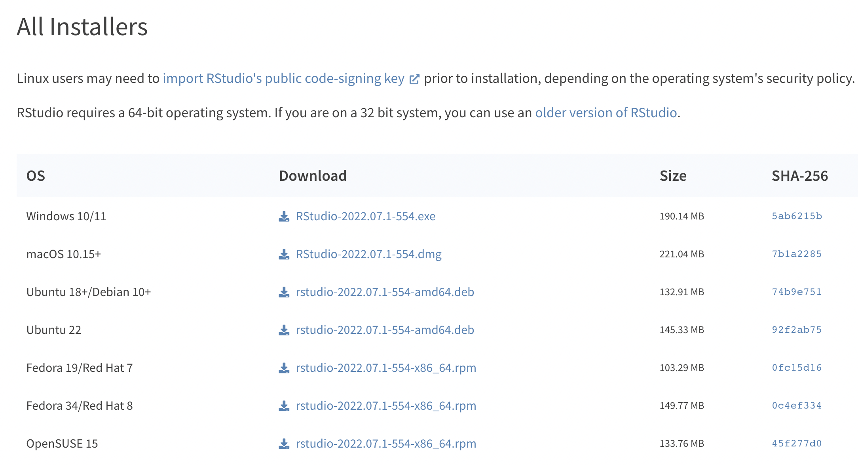
R Studio Overview

Slide 30
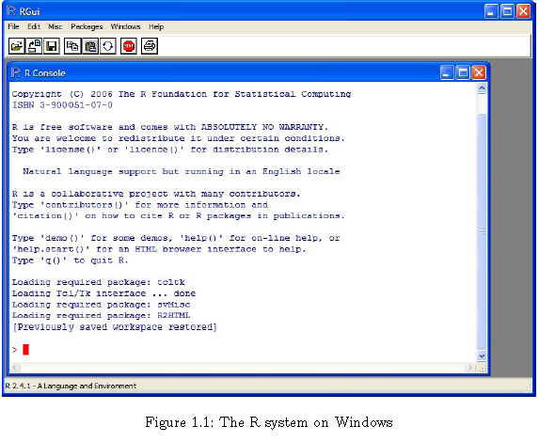
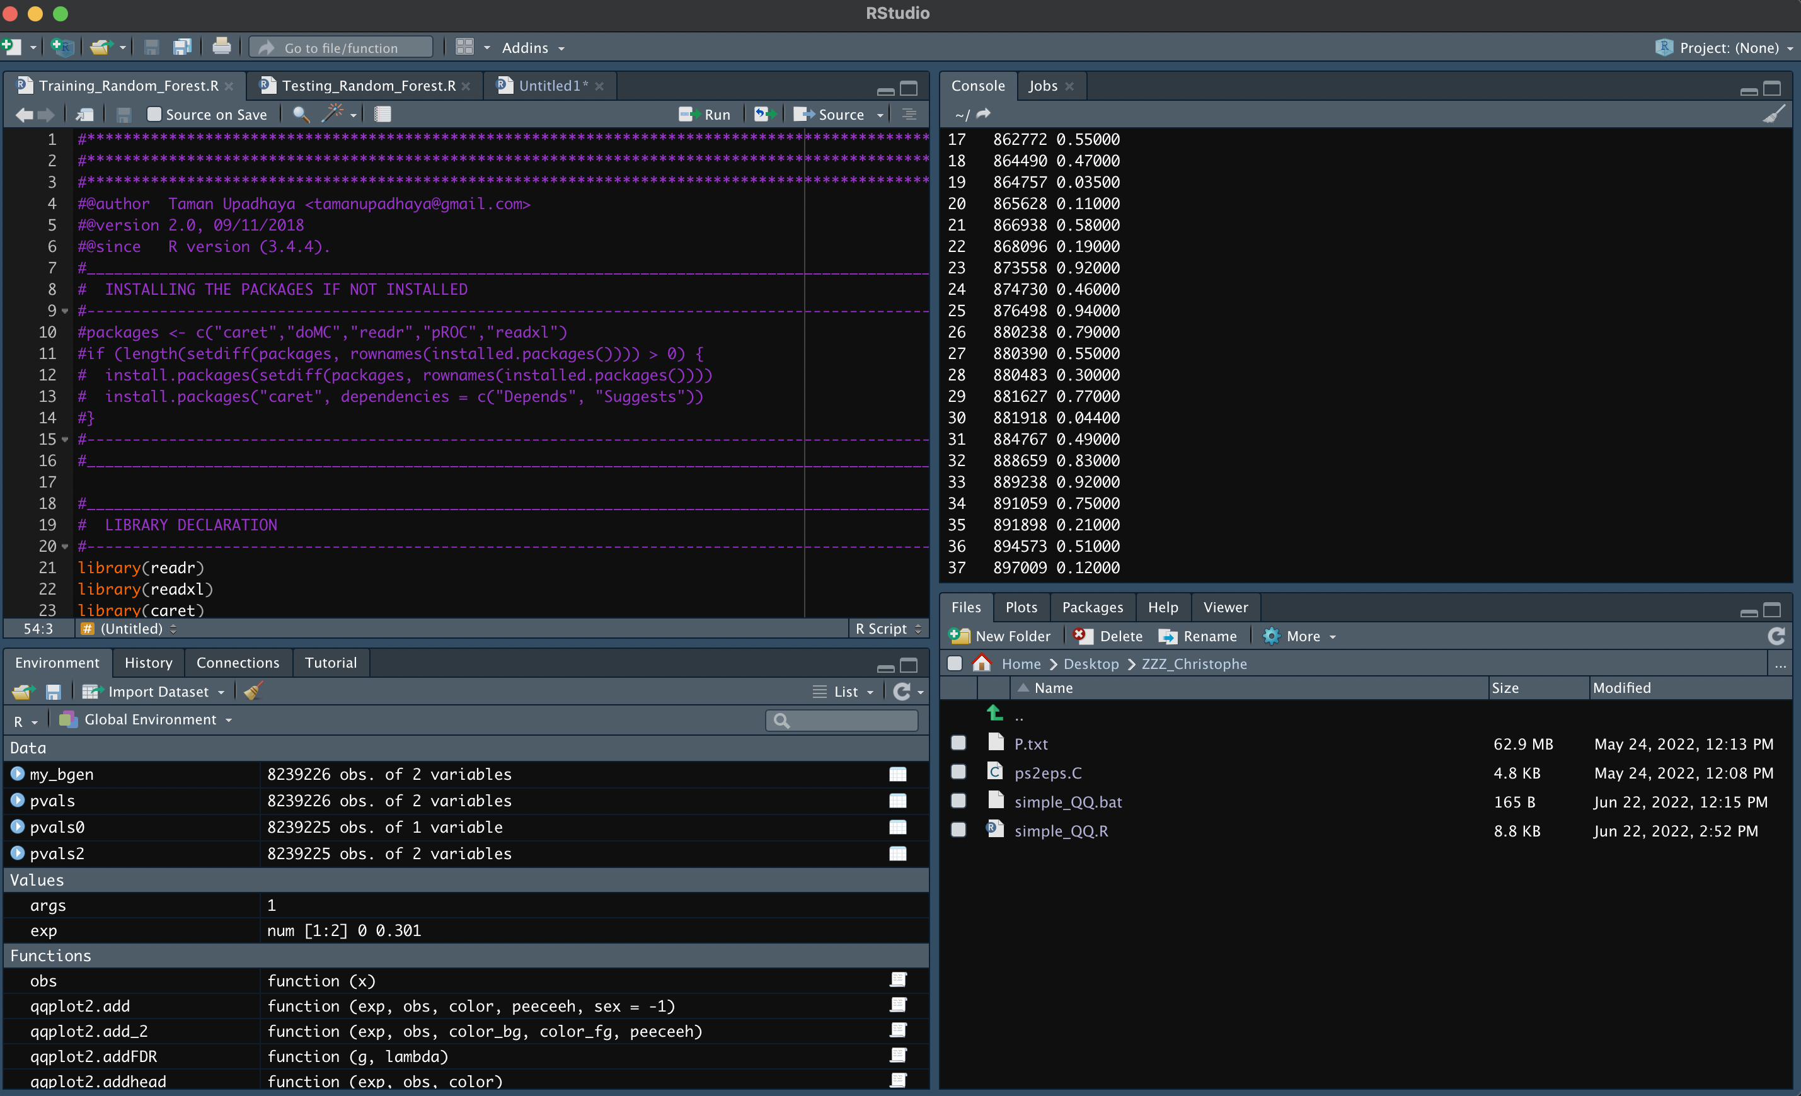
Your First R and R Studio Session

Slide 31
R Overview
Most functionality is provided through built-in and user-created functions and all data objects are kept in memory during an interactive session.
Basic functions are available by default. Other functions are contained in packages that can be attached to a current session as needed.
A key skill to using R effectively is learning how to use the built-in help system. Other sections describe the working environment, inputting programs and outputting results, installing new functionality through packages and etc.
A fundamental design feature of R is that the output from most functions can be used as input to other functions. This is described in reusing results.

Slide 32
R Overview
You can enter commands one at a time at the command prompt (>) or run a set of commands from a source file.
Results of calculations can be stored in objects using the assignment operators:An arrow (<-) formed by a smaller than character and a hyphen without a space!The equal character (=).
There is a wide variety of data types, including vectors (numerical, character, logical), matrices, data frames, and lists.
To quit R, use >q().
Start the R system, the main window (RGui) with a sub window (R Console) will appear
In the `Console' window the cursor is waiting for you to type in some R commands.

Slide 33
R Introduction
To list the objects that you have in your current R session use the function ls or the function objects.
> ls()
[1] "x" "y"
So, to run the function ls we need to enter the name followed by an opening ( and a closing ). Entering only ls will just print the object, you will see the underlying R code of the the function ls. Most functions in R accept certain arguments. For example, one of the arguments of the function ls is pattern. To list all objects starting with the letter x:
> x2 = 9
> y2 = 10
> ls(pattern="x")
[1] "x" "x2"

Slide 34
R Introduction
If you assign a value to an object that already exist then the contents of the object will be overwritten with the new value (without a warning!). Use the function rm to remove one or more objects from your session.
> rm(x, x2)
Let’s create two small vectors with data and a scatterplot.
z2 <- c(1,2,3,4,5,6)
z3 <- c(6,8,3,5,7,1)
plot(z2,z3)
title("My first scatterplot")

Slide 35
R Warning!
R is a case sensitive language!
FOO, Foo, and foo are three different objects

Slide 36
R Workspace
Objects that you create during an R session are hold in memory, the collection of objects that you currently have is called the workspace. This workspace is not saved on disk unless you tell R to do so. This means that your objects are lost when you close R and not save the objects, or worse when R or your system crashes on you during a session.
When you close the RGui or the R console window, the system will ask if you want to save the workspace image. If you select to save the workspace image, then all the objects in your current R session are saved in a file .RData. This is a binary file located in the working directory of R, which is by default the installation directory of R.

Slide 37
R Workspace
During your R session you can also explicitly save the workspace image. Go to the `File‘ menu and then select `Save Workspace...', or use the save.image function.
## save to the current working directory
save.image()
## just checking what the current working directory is
getwd()
## save to a specific file and location
save.image("C:\\Program Files\\R\\R-2.5.0\\bin\\.RData")

Slide 38
R Workspace
If you have saved a workspace image and you start R the next time, it will restore the workspace. So, all your previously saved objects are available again. You can also explicitly load a saved workspace, that could be the workspace image of someone else. Go the `File' menu and select `Load workspace...’.
Commands are entered interactively at the R user prompt. Up and down arrow keys scroll through your command history. You will probably want to keep different projects in different physical directories.
R gets confused if you use a path in your code like c:\mydocuments\myfile.txt
This is because R sees "\" as an escape character. Instead, use
c:\\my documents\\myfile.txt or
c:/mydocuments/myfile.txt

Slide 39
R Workspace
getwd() # print the current working directory
ls() # list the objects in the current workspace
setwd(mydirectory) # change to mydirectory
setwd("c:/docs/mydir")
# save your command history savehistory(file="myfile") # default is ".Rhistory"
# recall your command history loadhistory(file="myfile") # default is ".Rhistory“

Slide 40
R Workspace
#view and set options for the session help(options) # learn about available options
options() # view current option settings options(digits=3) # number of digits to print on output
# work with your previous commands history() # display last 25 commands history(max.show=Inf) # display all previous commands

Slide 41
R Help
Once R is installed, there is a comprehensive built-in help system. At the program's command prompt, you can use any of the following:
help.start() # general help help(foo) # help about function foo ?foo # same thing apropos("foo") # list all function containing string foo example(foo) # show an example of function foo

Slide 42
R Help
# search for foo in help manuals and archived mailing lists RSiteSearch("foo")
# get vignettes on using installed packages vignette() # show available vingettes vignette("foo") # show specific vignette

Slide 43
R Datasets
R comes with a number of sample datasets that you can experiment with. Type
> data( )
to see the available datasets. The results will depend on which packages you have loaded. Type
help(datasetname)
for details on a sample dataset.

Slide 44
R Packages
One of the strengths of R is that the system can easily be extended. The system allows you to write new functions and package those functions in a so called `R package' (or `R library'). The R package may also contain other R objects, for example data sets or documentation. There is a lively R user community and many R packages have been written and made available on CRAN for other users. Just a few examples, there are packages for portfolio optimization, drawing maps, exporting objects to html, time series analysis, spatial statistics and the list goes on and on.

Slide 45
R Packages
When you download R, already a number (around 30) of packages are downloaded as well. To use a function in an R package, that package has to be attached to the system. When you start R not all of the downloaded packages are attached, only seven packages are attached to the system by default. You can use the function search to see a list of packages that are currently attached to the system, this list is also called the search path.
> search()
[1] ".GlobalEnv" "package:stats" "package:graphics"
[4] "package:grDevices" "package:datasets" "package:utils"
[7] "package:methods" "Autoloads" "package:base"

Slide 46
R Packages
To attach another package to the system you can use the menu or the library function. Via the menu:
Select the `Packages' menu and select `Load package...', a list of available packages on your system will be displayed. Select one and click `OK', the package is now attached to your current R session. Via the library function:
> library(MASS)
> shoes
$A
[1] 13.2 8.2 10.9 14.3 10.7 6.6 9.5 10.8 8.8 13.3
$B
[1] 14.0 8.8 11.2 14.2 11.8 6.4 9.8 11.3 9.3 13.6

Slide 47
R Packages
The function library can also be used to list all the available libraries on your system with a short description. Run the function without any arguments
> library()
Packages in library 'C:/PROGRA~1/R/R-25~1.0/library':
base The R Base Package
Boot Bootstrap R (S-Plus) Functions (Canty)
class Functions for Classification
cluster Cluster Analysis Extended Rousseeuw et al.
codetools Code Analysis Tools for R
datasets The R Datasets Package
DBI R Database Interface
foreign Read Data Stored by Minitab, S, SAS, SPSS, Stata, Systat, dBase, ...
graphics The R Graphics Package

Slide 48
R Packages
install = function() {
install.packages(c("moments","graphics","Rcmdr","hexbin"),
repos="http://lib.stat.cmu.edu/R/CRAN")
}
install()

Slide 49
R Conflicting objects
It is not recommended to do, but R allows the user to give an object a name that already exists. If you are not sure if a name already exists, just enter the name in the R console and see if R can find it. R will look for the object in all the libraries (packages) that are currently attached to the R system. R will not warn you when you use an existing name.
> mean = 10
> mean
[1] 10
The object mean already exists in the base package but is now masked by your object mean. To get a list of all masked objects use the function conflicts.
>
[1] "body<-" "mean"

Slide 50
R Conflicting objects
The object mean already exists in the base package but is now masked by your object mean. To get a list of all masked objects use the function conflicts.
> conflicts()
[1] "body<-" "mean“
You can safely remove the object mean with the function
rm() without risking deletion of the mean function.
Calling rm() removes only objects in your working environment by default.

Slide 51
Source Codes
You can have input come from a script file (a file containing R commands) and direct output to a variety of destinations.
Input
The source( ) function runs a script in the current session. If the filename does not include a path, the file is taken from the current working directory.
# input a script source("myfile")

Slide 52
Graphs
To redirect graphic output use one of the following functions. Use dev.off( ) to return output to the terminal.
Function | Output to
pdf("mygraph.pdf") | pdf file
win.metafile("mygraph.wmf") | windows metafile
png("mygraph.png") | png file
jpeg("mygraph.jpg") | jpeg file
bmp("mygraph.bmp") | bmp file
postscript("mygraph.ps") | postscript file
# example - output graph to jpeg file jpeg("c:/mygraphs/myplot.jpg") plot(x) dev.off()

Slide 53
Reusing Results
One of the most useful design features of R is that the output of analyses can easily be saved and used as input to additional analyses.
# Example 1 lm(mpg~wt, data=mtcars)
This will run a simple linear regression of miles per gallon on car weight using the dataframe mtcars. Results are sent to the screen. Nothing is saved.

Slide 54
Reusing Results
# Example 2 fit <- lm(mpg~wt, data=mtcars)
This time, the same regression is performed but the results are saved under the name fit. No output is sent to the screen. However, you now can manipulate the results.
str(fit) # view the contents/structure of "fit“
The assignment has actually created a list called "fit" that contains a wide range of information (including the predicted values, residuals, coefficients, and more.

Slide 55
Reusing Results
# plot residuals by fitted values plot(fit$residuals, fit$fitted.values)
To see what a function returns, look at the value section of the online help for that function. Here we would look at help(lm).
The results can also be used by a wide range of other functions.
# produce diagnostic plots
plot(fit)

Slide 56
Reading Materials
Davies, T. M. (2016). The book of R : a first course in programming and statistics. No Starch Press.
Grolemund, G., & Hadley Wickham. (2015). Hands-on programming with R. Beijing Cambridge Farnham Koln Sebastopol Tokyo O’reilly Beijing Cambridge Farnham Koln Sebastopol Tokyo O’reilly -01-23.
Rizzo, M. L. (2019). Statistical computing with R. Boca Raton [U.A.] Chapman Et Hall/Crc.
Long J., and Teetor, P. (2019, September 26). R Cookbook, 2nd Edition. Rc2e.com. https://rc2e.com/
Ross, S. M. (2006). Simulation. Elsevier Academic Press.

Slide 57
FIN

